Slide 1
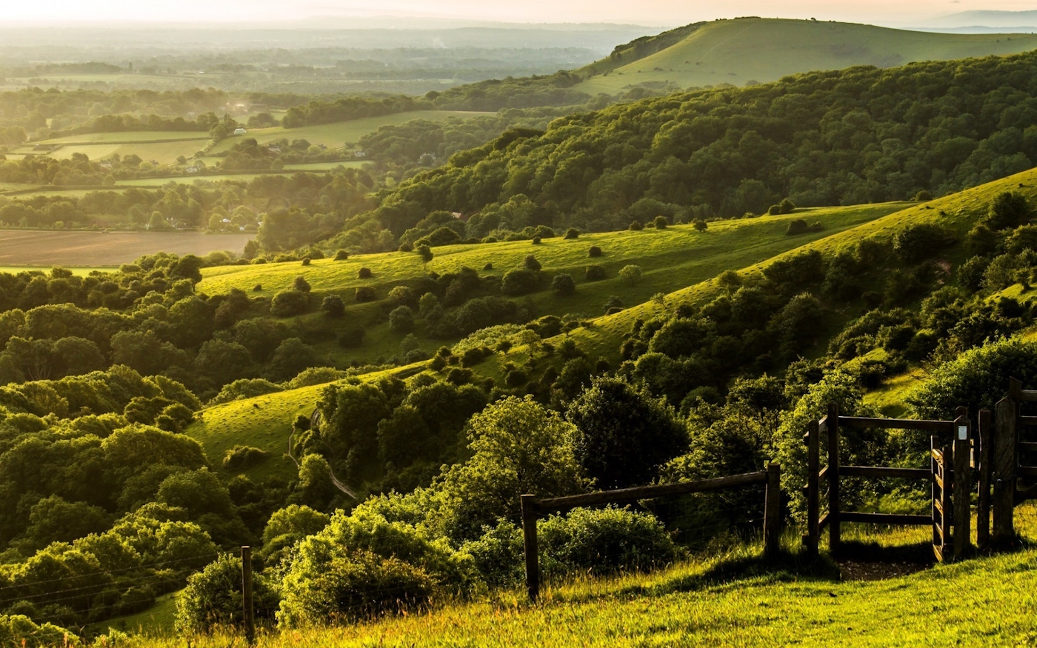


30|30|30
NATURE | CLIMATE | NOW
For health
For prosperity
For resilience
For people
Rebuilding Nature is a cross-sector alliance treating nature as critical national infrastructure.
Together we’re building a shared brand to inspire, engage, and drive confident investment in nature.
Our vision:
Strategic Nature Network (SNN)
Nature Investment Zones (NIZ)
Resilient Processes: Restrating natural systems to secure climate resilience.
Contributing to:

Slide 2
30|30|30
NATURE | CLIMATE | NOW
For health
For prosperity
For resilience
For people
Why a Strategic Nature Network?
We have breached the safe limits of the living system that supports us as a species.
We now have to restore ecosystems globally to preserve a safe operating space for humanity and maintain a thriving economy.
The UK Government has committed to “ensure that by 2030 at least 30 per cent of areas of degraded terrestrial, inland water, and marine and coastal ecosystems are under effective restoration, in order to enhance biodiversity and ecosystem functions and services, ecological integrity and connectivity”.
At the same time, 30% of the world’s carbon emissions can be dealt with through natural climate solutions - including restoration of native habitat.
Contributing to:

Slide 3
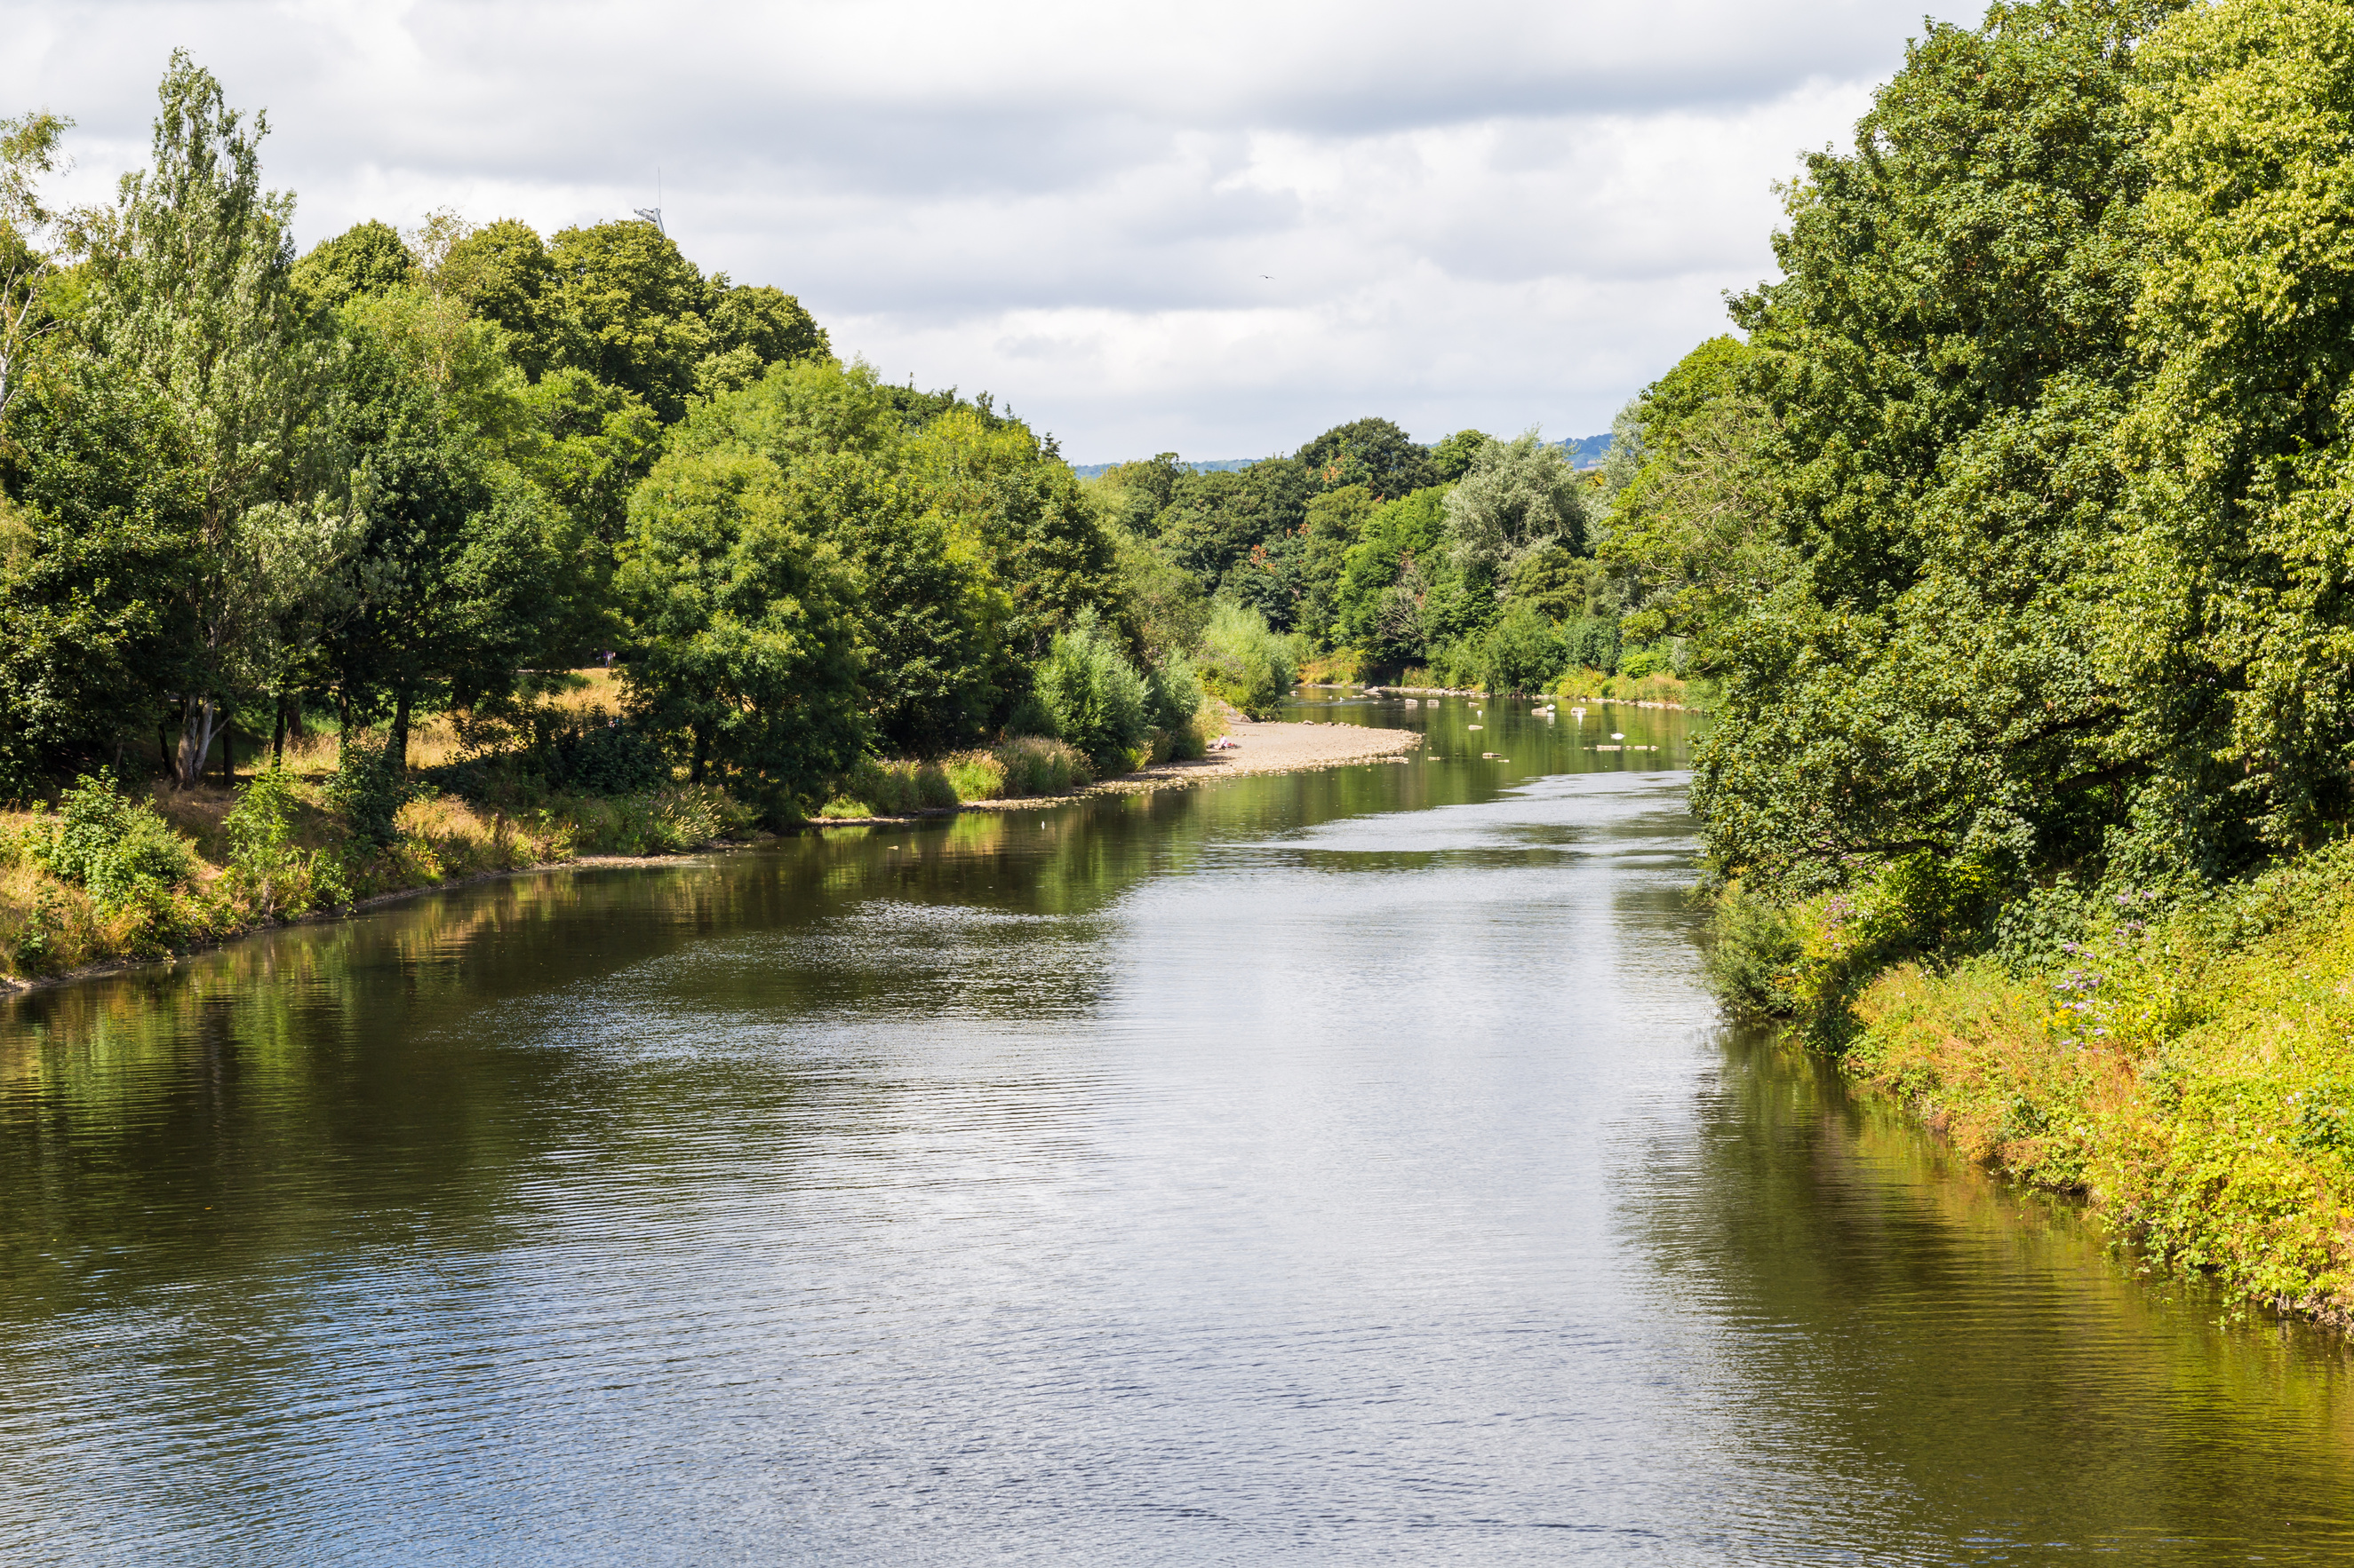
30|30|30
NATURE | CLIMATE | NOW
For health
For prosperity
For resilience
For people
Our target is to accelerate action towards:
“30% of land and sea being restored by nature for people, and dealing with 30% of the UK’s emissions reductions by 2030”.
Contributing to:

Slide 4

30|30|30
NATURE | CLIMATE | NOW
What is the
Strategic Nature Network?
The SNN is a national construct that overlays local nature recovery priorities and thematic initiatives providing a single collective strategic investment vehicle, underpinned by Lawton principles for natural process driven functional ecosystems.
All of this ensures that nature is treated as foundational infrastructure for climate resilience, economic prosperity, and community wellbeing.
UK wide land-use decision framework
Strategic ambition to realise UK PLC targets for nature and climate
Collective Investment vehicle
Strategic deployment of investment into nature for UK resilience
Ecological connectivity and evidence of effectiveness from more, bigger, better and more joined natural infrastructure. Providing a core nature network that holds weight in land and sea use decisions.
Contributing to:

Slide 5
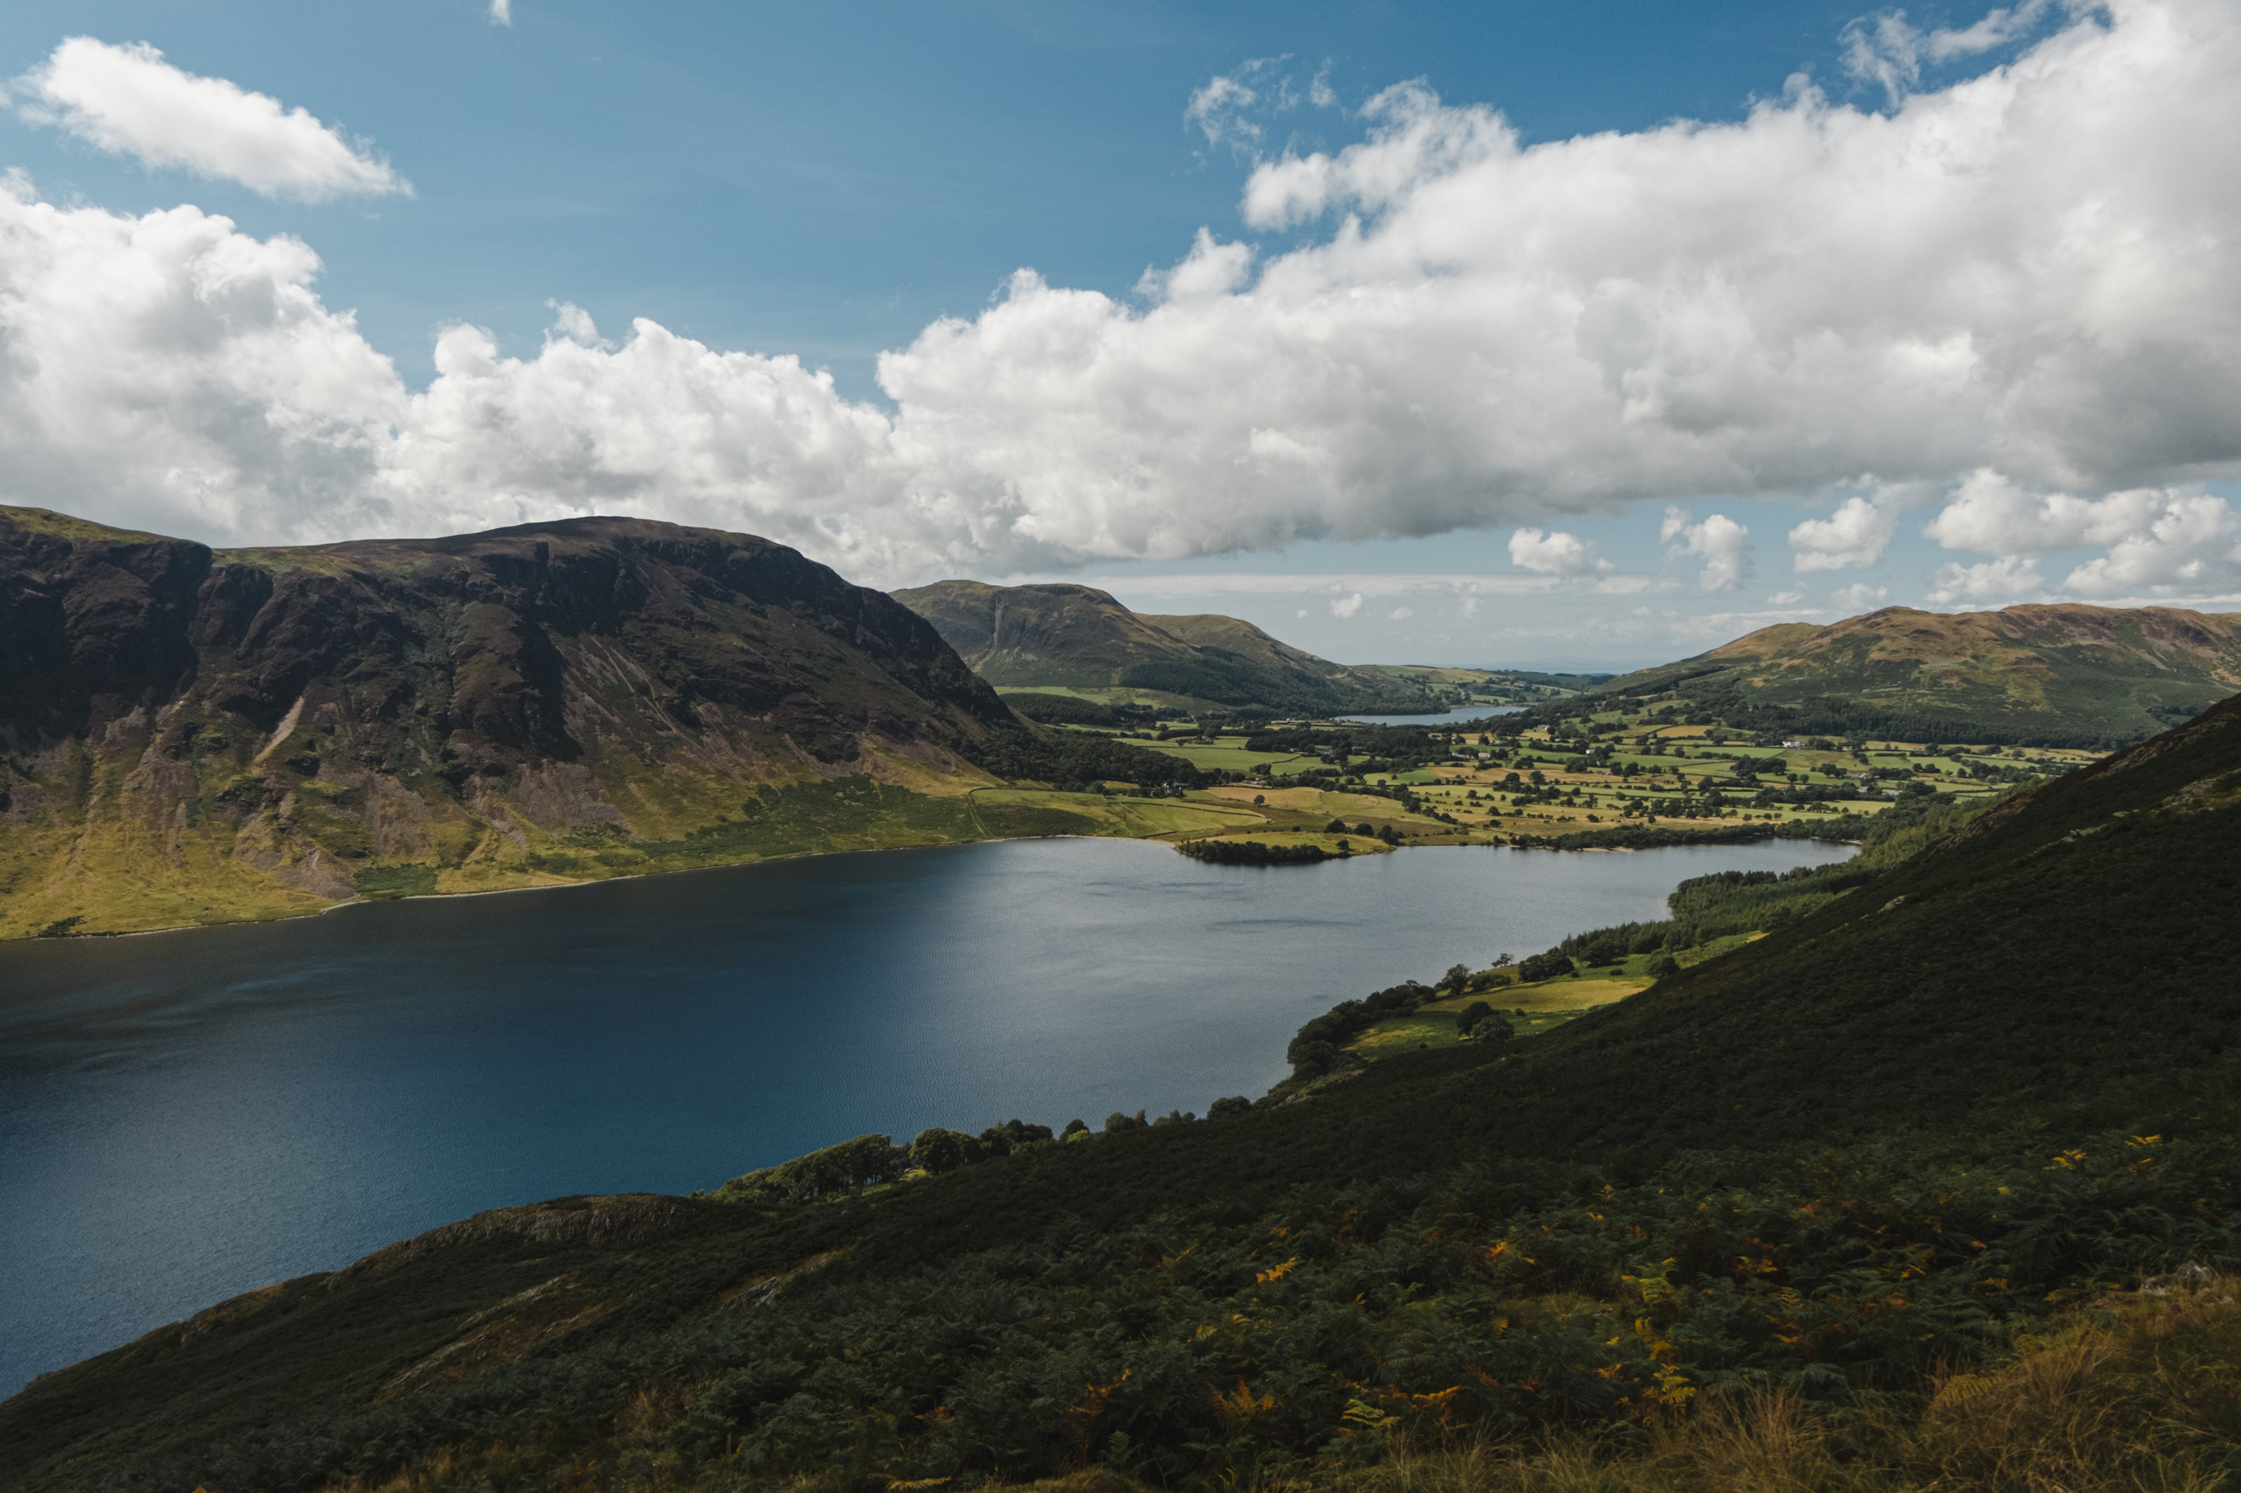
30|30|30
NATURE | CLIMATE | NOW
What is the Strategic Nature Network
National Scale Components:
Mapping and Layering Concept vs Full Detail
Provide a national picture of where interventions will have the greatest ecological, climate, and societal impact.
Governance
and Oversight
Ensure integrity (high quality natural process), alignment, and accountability across the network. SNN Advisory Group. SNN use for strategic decision making/planning.
Proven Investment and Finance Mechanisms
Unlock large-scale, blended finance into nature recovery at place and national levels leveraging the NIZ model.
Monitoring, Evaluation and Evidence
Demonstrate the effectiveness of the SNN via ecological, social, and economic returns contributing toward national nature and climate targets.
Comunication and
Engagement Plan
Inspire, Build legitimacy, attract partners, and maintain political/public momentum.
For health
For prosperity
For resilience
For people
Contributing to:

Slide 6
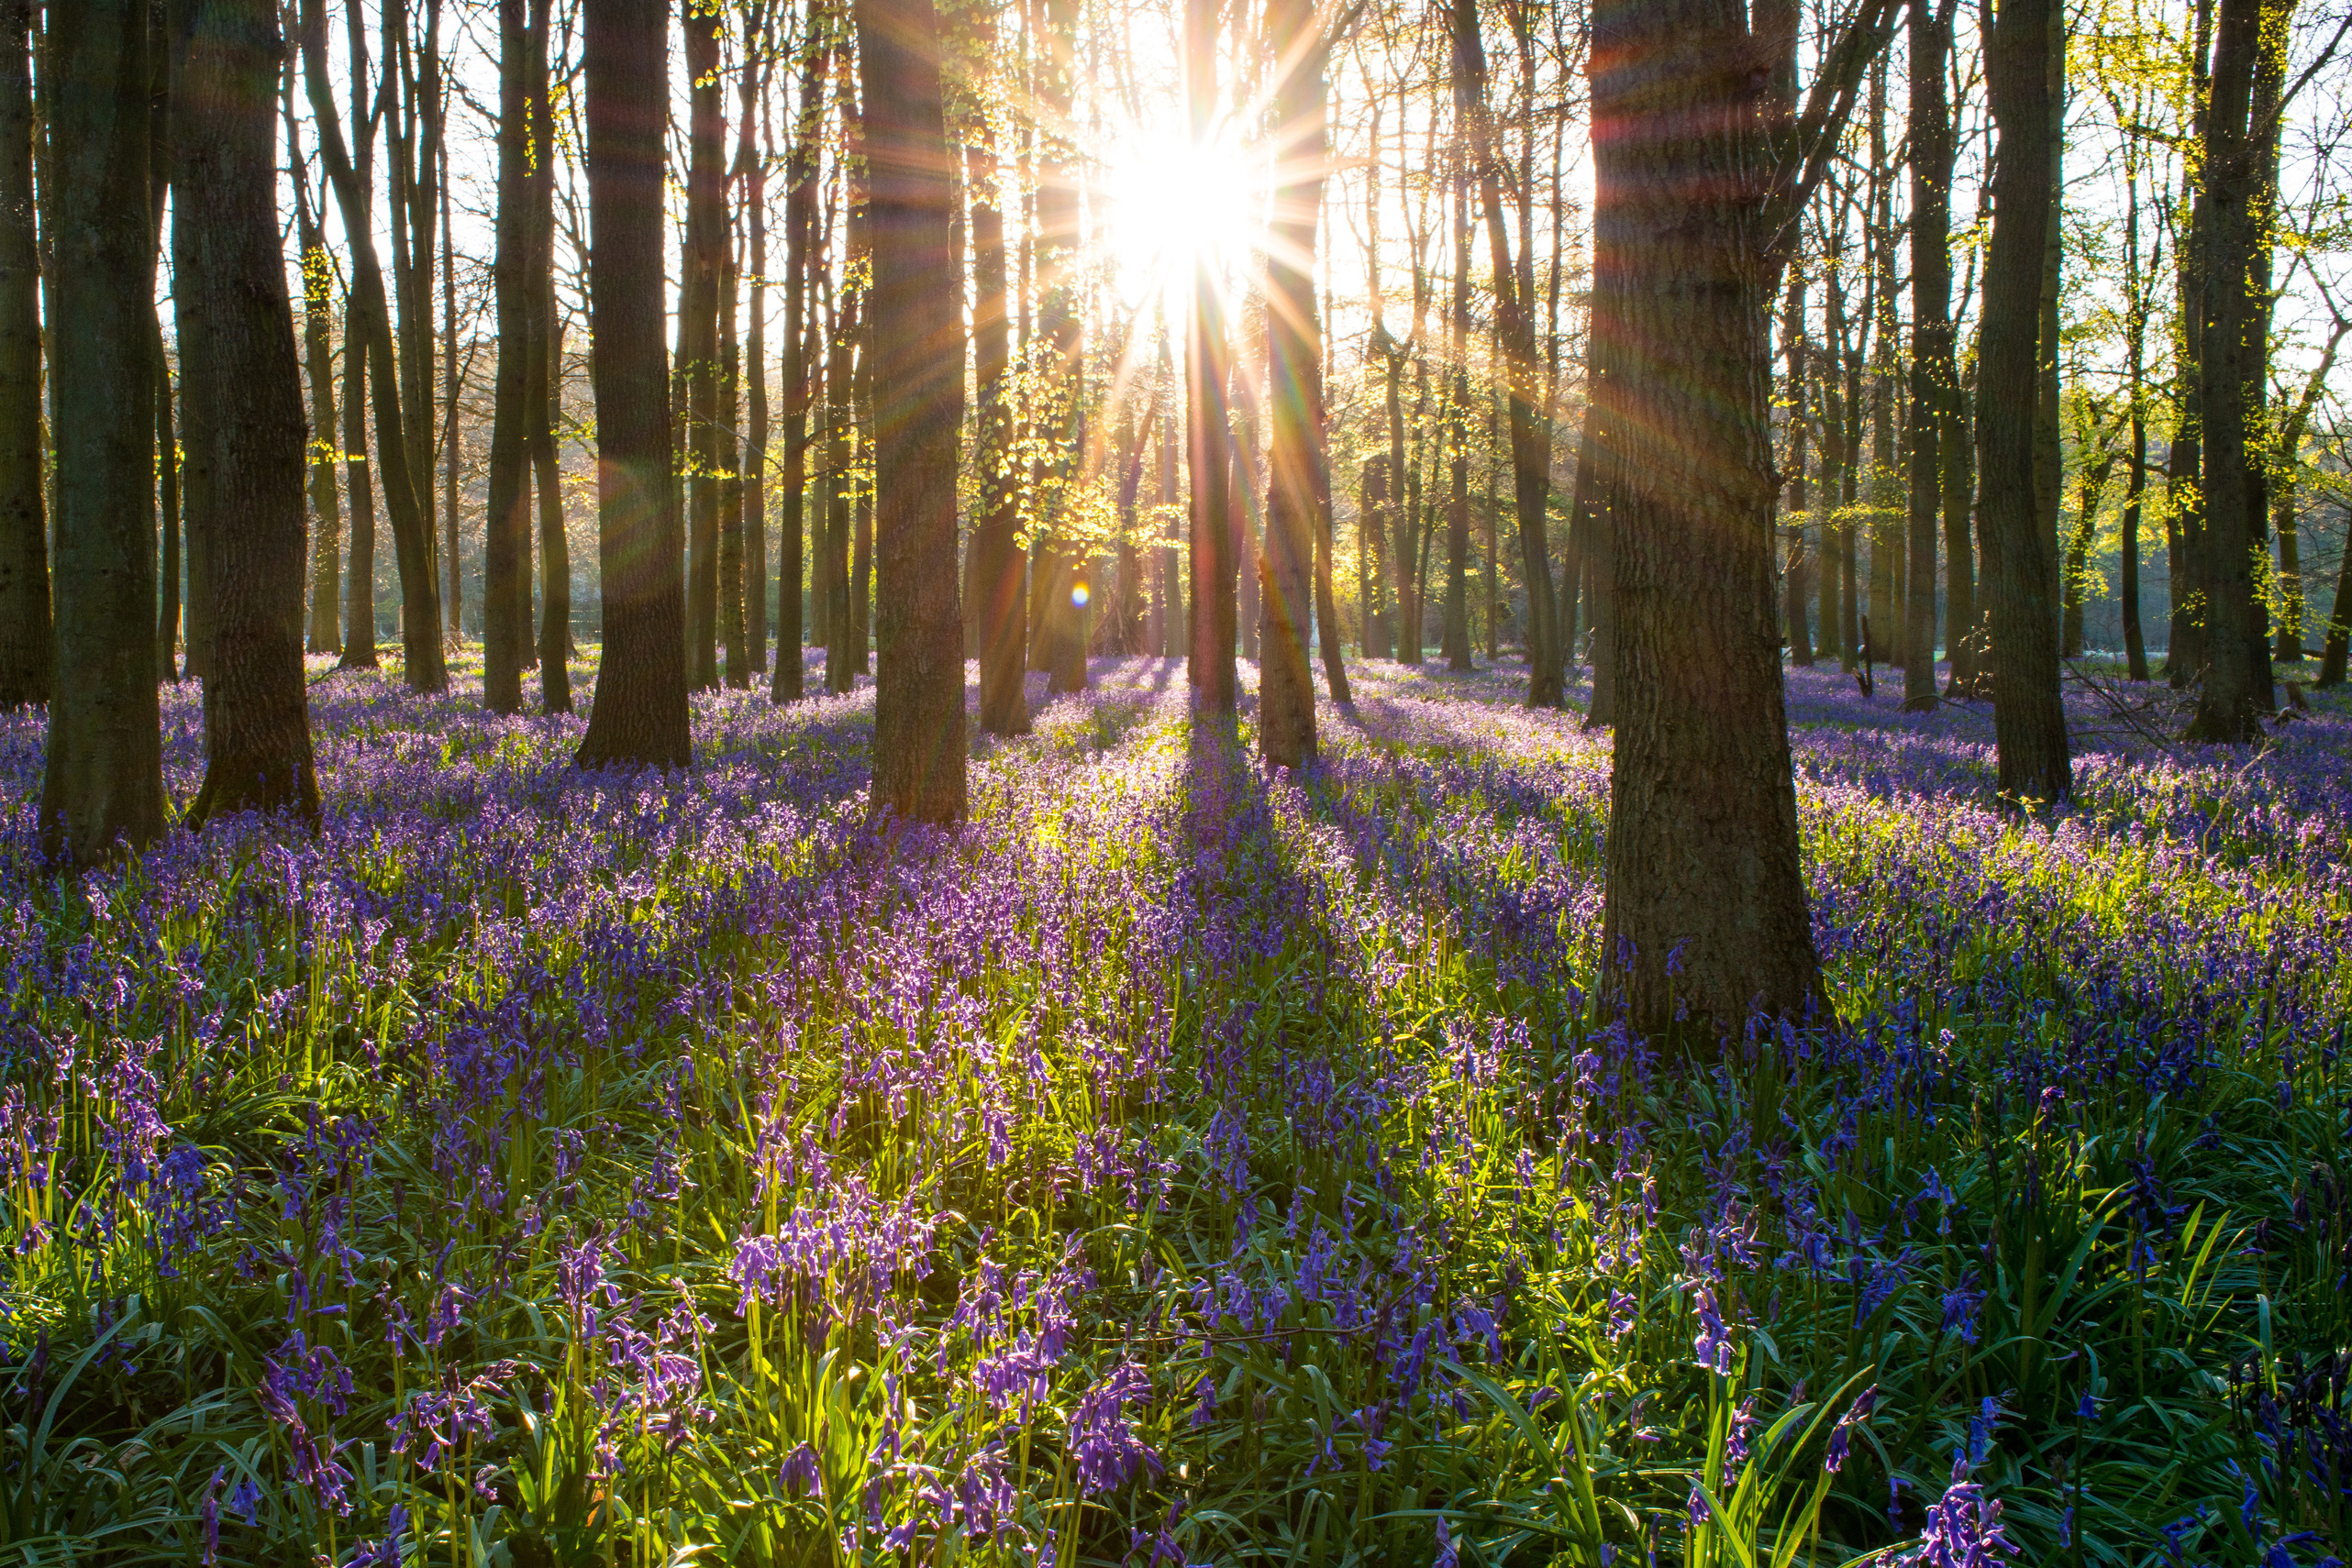
30|30|30
NATURE | CLIMATE | NOW
For health
For prosperity
For resilience
For people
What are Nature Investment Zones?
A Nature Investment Zones (NIZ) is the foundational building block of the SNN, each NIZ serving as localised hubs for investment, governance, and delivery. By bringing together investors, landowners, communities and nature to create large-scale impact.
Contributing to:

Slide 7

30|30|30
NATURE | CLIMATE | NOW
Join us to rebuild nature for everyone
www.rebuildingnature.com
Contributing to:

